Slide 1


Kubernetes Extension Points With Deep Dive into Custom Resource Definitions
Jungho Kim, Architech
December 11, 2018

Slide 2
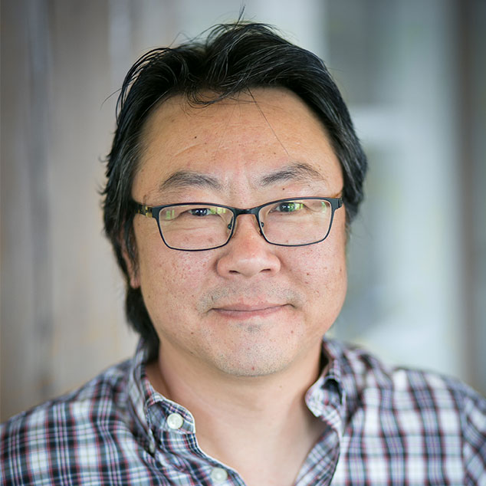
In 90 minutes…
Quick overview of Kubernetes extensions points then focus on Custom Resource Definitions (CRDs) and Custom Controllers
Deep dive into CRDs, the basis for “Operators”
Use-cases from the community
Prometheus Operator
Roll your own example to get the concept
Using Kubebuilder
Using Operator SDK
Twitter: @jungho_kim
LinkedIn: @junghokim
GitHub: @jungho
https://github.com/jungho/k8s-crds

Slide 3

Desired Outcome
Learn how extensible K8S can be
Understand better the inner workings of Kubernetes
Spark your imagination to leverage Kubernetes in more powerful ways
Start your journey to becoming Kubernetes ninjas!

Slide 4


Slide 5
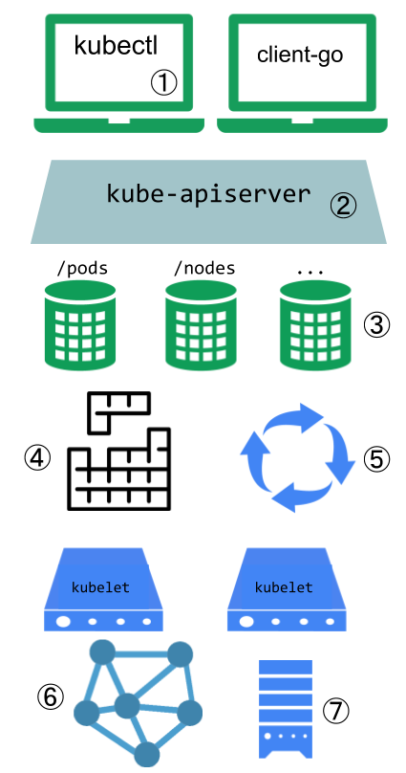
Kubernetes Extension Points
K8S is incredibly extensible
Designed with well-defined extension points to extend/customize the platform
Plugins for kubectl to add additional kubectl commands (you can’t overwrite existing commands)
Authn/Authr, Webhooks, Admission Controllers, Dynamic Admission Control, API Aggregation
Custom Resource Definitions
Scheduler extensions. You can replace the default scheduler, use multiple schedulers, extend scheduler behaviours via webhooks
Controllers that reconciles current-state to desired state.
Network Plugins e.g. Container Network Interface (CNI) plugins such as Celium, Calico, Azure CNI
Storage Plugins e.g. Flex Volumes
https://bit.ly/2r6qKTp

Slide 6
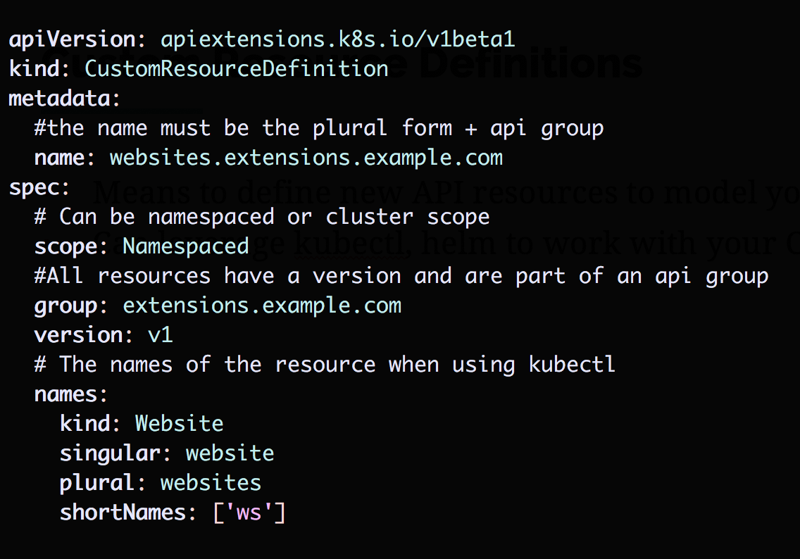
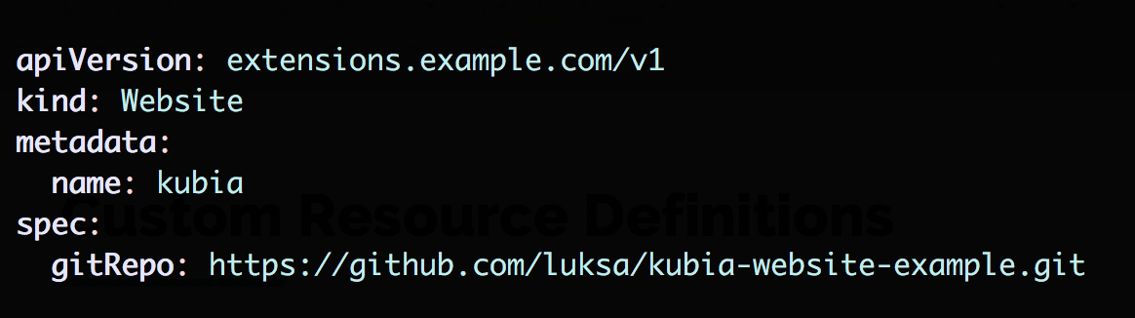
Custom Resource Definitions
Means to define new API resources to model your domain
Can leverage kubectl, helm to work with your CRDs
Instance of CRD
The CRD

Slide 7
Custom Contollers
CRDs alone don’t do anything
Something needs to consume instances of a CRD and take action, that is the Controller
In simple terms, a controller is responsible for:
Watching for specific resource types e.g. Website
Reconciling the desired state, and doing so continuously (this is what makes K8S so resilient!!)

Slide 8
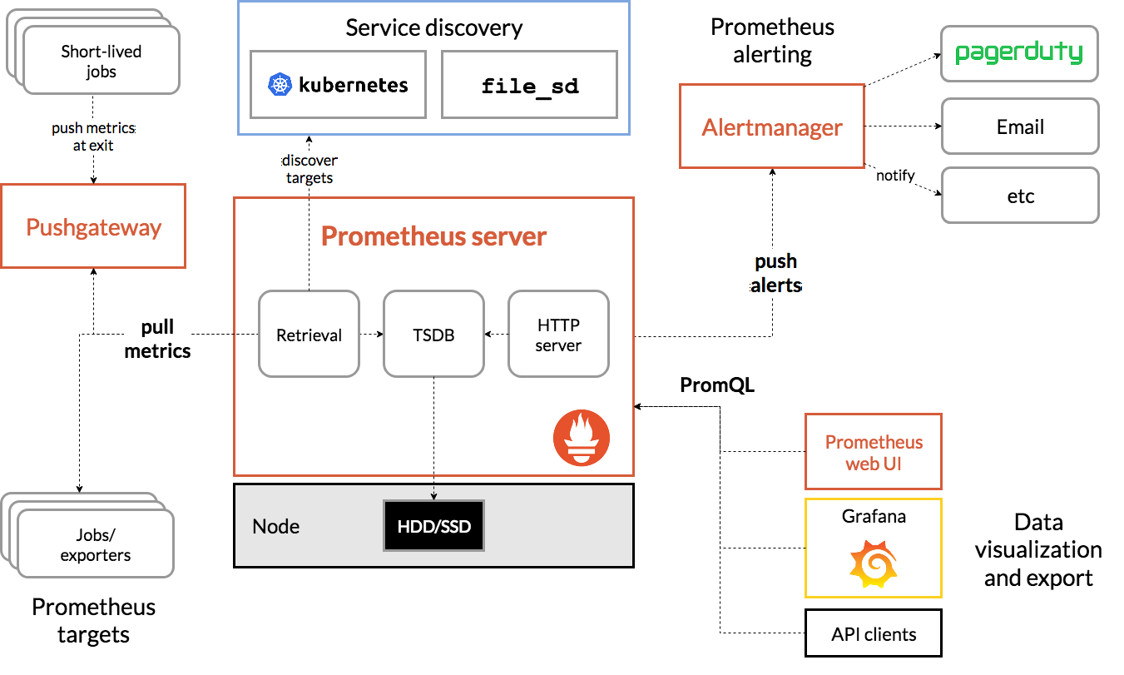
Prometheus
https://prometheus.io/docs/introduction/overview/

Slide 9








Operators
https://github.com/operator-framework/awesome-operators

Slide 10


Slide 11
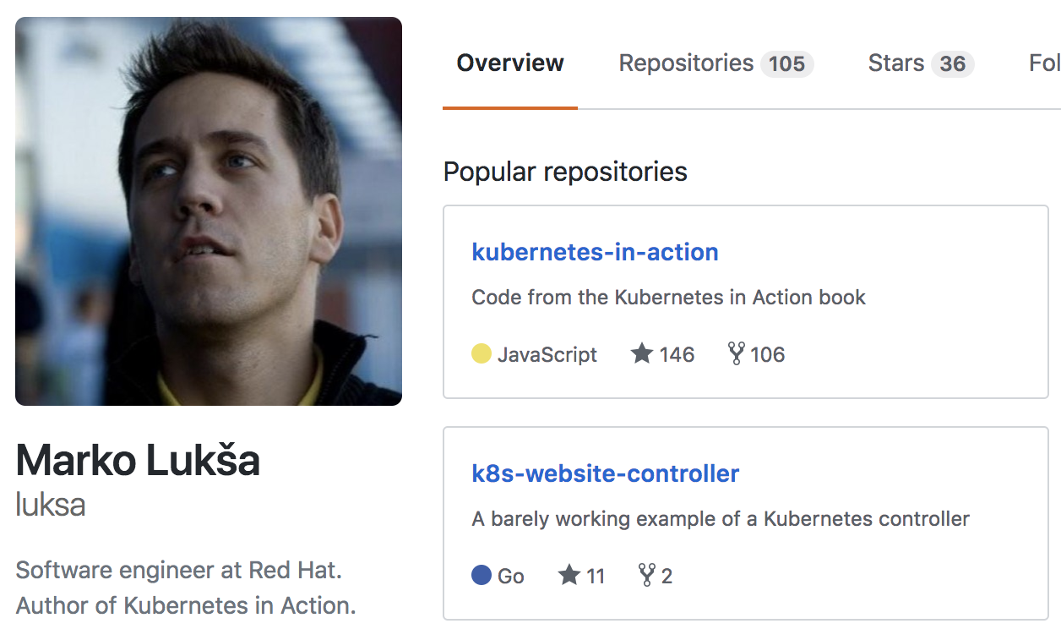

First CRD Example…. Thank You Lukša!
https://github.com/luksa/k8s-website-controller

Slide 12
KubeBuilder
Part of the core Kubernetes projects, part of the apimachinery SIG (Special Interest Group)
https://github.com/kubernetes-sigs
GA version v1.0.5, so stable
Excellent documentation at https://book.kubebuilder.io/
Provides scaffolding to quickly get started including:
Generate CRD, CRD instance
Golang code for Controller, Manager, CRD Types, Reconciler, tests
Deployment manifests
RBAC manifests
Makefile to build, test, deploy your CRD and custom controller

Slide 13

Operator SDK
Created by the CoreOS team that coined ”Operator”
Still “alpha” but used for many published operators
Supports both golang and Ansible implementations
Leverages controller-runtime package which is a sub-project of kubebuilder
Excellent documentation here https://bit.ly/2U8RXCt
Provides scaffolding to quickly get started including:
Generate CRD, CRD instance
Golang code for Controller, Manager, CRD Types, Reconciler
Deployment manifests
RBAC manifests
Does not provide a nice Makefile to help with workflow so you need to write some scripts

Slide 14

We use open source, cloud-native technologies to modernize systems.
Notes:
14 Years
300+ Projects
Enterprise Story
Entrepreneurial
Modernize: Government, Banks, Canadian Tire, Telcos
Integrated Team Approach, over 100 people
Mix of Product Innovation, Modernization, and enabling / empowering the existing teams.
We build platforms and digital products.

Slide 15








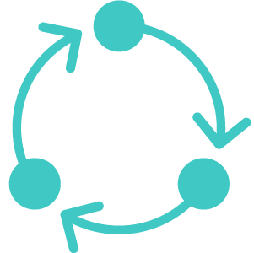


Integrated Development Studio
+
+
14
300
Strategy
Design
Engineering
Analytics
Support
years
projects
Digital Transformation
Product Innovation
Legacy Modernization
Team Enablement
+
+
100
40
Modern Product Development
people
systems modernized
Lean
Startup
Design Thinking
Agile Engineering
Notes:
We know that great software development takes a customer-first approach, embracing innovation, experimentation and discipline.
Integrated Team Approach, over 100 people
Mix of Product Innovation, Modernization, and enabling / empowering the existing teams.
We build platforms and digital products.

Slide 16

























Digital Transformation Journeys
Notes:
These are mostly incumbents.
Modernize: Government, Banks, Canadian Tire, Telcos

Slide 17


“
We’re trying to become an organization that’s constantly rethinking the problems we’re solving in the market today and looking to bring new value to clients in ways that they haven’t thought of yet. Architech is instrumental to us throughout this journey.
Hugh Cumming, Chief Technology Officer, Finastra ($2B+ fintech)
Notes:
Here’s an incumbent, formerly D+H (the cheque company), that is re-inventing themselves to become the world’s largest fintech.

Slide 18







Open Source Experts in the Cloud
Reduced Costs
Enhanced Supportability
Massive Global Adoption
Avoid Vendor Lock-In
Availability, Resiliency, Security
Achieve True Business Agility

Slide 19

70 Bond St., Suite 400 Toronto, ON, Canada M5B 1XB
P: 416.607.5618 F: 416.352.1768 www.architech.ca
©2017 Architech. All Rights Reserved.

